Slide 1
Monitor Riser
Productivity at your desk

Slide 2
By sourabh ursal mayuresh sardesai prasanna tayade
Project guide: Prof. Mr. N.P. Deshpande

Slide 3
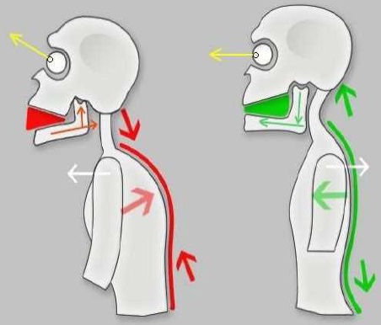
Why adjustability matters ?
Unbalanced head and neck: as the head tilts force on the spine increases 27N at 60 degrees
Balanced head and neck: neutral posture average head weighs 5N

Slide 4
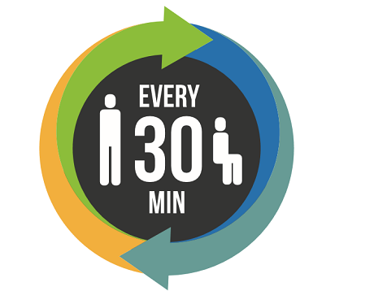
That Annoying Fidgeting Could Be Good for You
30 minutes SIT-STAND Formula
Comfortable computing is a good economic investment. Not only are cost reduced associated with healthcare and missed time, but productivity increases too.

Slide 5
Convenience meets comfort
Why put up with default monotone setting
We know that choice make a great deal in our life then why not to our desktop
Therefore our product comes in 3 modes:
Manual, timer and automatic
Chose according to your convenience

Slide 6
Highlights
Easily extendable Linear actuator for precise control of desired height.
Modular design allows you to configure the system to suit your specific requirements.
Compact footprint i.e. it takes minimum desk space and avoids clutter.
Durable aluminum and steel construction.

Slide 7
About Monitor riser
Back on Track
Technical Specification:
A standalone device 230V 50Hz AC input
Pre-assembled setup with adjustable height 3-5’1/2 feet
3 modes of operation Manual, auto and timing based
Safety switches on both sides
Full scale movement in 40 sec

Slide 8
Auto mode
The state of the art module has 3 Infrared Sensor of range 80 cm Detects any change in position and efficiently determines whether the user is standing and vice versa
It neglects any short term disturbances caused by any obstacle which intercept the sensor.

Slide 9
Manual Mode
Timer Mode
Up and down motion controlled by push buttons.
Sit and stand period manually set by user.

Slide 10
Special thanks to
Prof. Mrs. V. Y. Deshmukh and Head of department Prof. Mr. P.G. Shete for their valuable guidance and support.
All teaching and non-teaching staff for extending their help.

Slide 11
Thank you

